Slide 1

Computer Architecture
Course Code: CSE360
Lecturer 12
Control Unit Operation

Slide 2
Micro-Operations
A computer executes a program
Fetch/execute cycle
Each cycle has a number of steps
  see pipelining
Called micro-operations
Each step does very little
Atomic operation of CPU

Slide 3
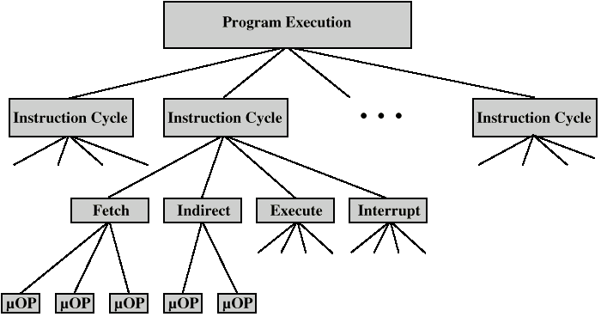
Constituent Elements of
Program Execution

Slide 4
Fetch - 4 Registers
Memory Address Register (MAR)
  Connected to address bus
  Specifies address for read or write op
Memory Buffer Register (MBR)
  Connected to data bus
  Holds data to write or last data read
Program Counter (PC)
  Holds address of next instruction to be fetched
Instruction Register (IR)
  Holds last instruction fetched

Slide 5
Fetch Sequence
Address of next instruction is in PC
Address (MAR) is placed on address bus
Control unit issues READ command
Result (data from memory) appears on data bus
Data from data bus copied into MBR
PC incremented by 1 (in parallel with data fetch from memory)
Data (instruction) moved from MBR to IR
MBR is now free for further data fetches

Slide 6
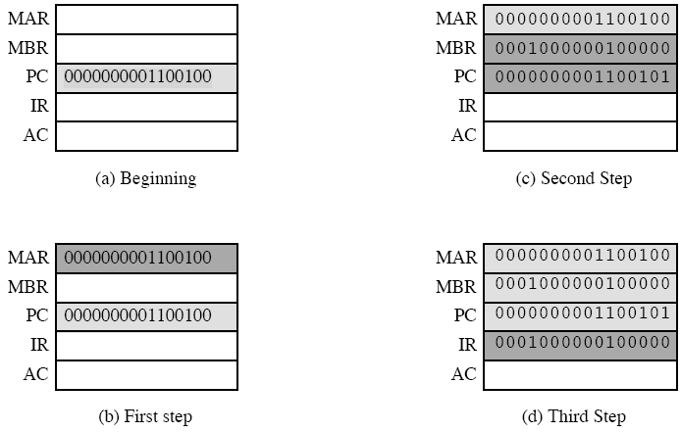
Sequence of Events, Fetch Cycle

Slide 7

Fetch Sequence (symbolic)
t1: MAR <- (PC)
t2: MBR <- (memory)
PC <- (PC) +1
t3: IR <- (MBR)
(tx = time unit/clock cycle)
Note that, the second and third micro-operations both take place during same time
Or, third could be have been grouped with fourth without affecting the fetch operation
t1: MAR <- (PC)
t2: MBR <- (memory)
t3: PC <- (PC) +1
IR <- (MBR)

Slide 8
Rules for Clock Cycle Grouping
Proper sequence must be followed
  MAR <- (PC) must precede MBR <- (memory)
Conflicts must be avoided
  Must not read & write same register at same time
  MBR <- (memory) & IR <- (MBR) must not be in same cycle
Also: PC <- (PC) +1 involves addition
  Use ALU
  May need additional micro-operations

Slide 9
Indirect Cycle
Once the instruction is fetched, the next step is to fetch source operands.
t1: MAR <- (IR_{address}) - address field of IR
(operand address)
t2: MBR <- (memory) (operand fetch)
t3: IR_{address} <- (MBR_{address}) (right most N bits)
The address field of the instruction is transferred to MAR
This is then used fetch the address of the operand
Finally, the address field of the IR is updated from the MBR, so that it now contains a direct rather than an indirect address

Slide 10

Interrupt Cycle
t1: MBR <-(PC)
t2: MAR <- save-address
PC <- routine-address
t3: memory <- (MBR)
This is a minimum
  The contents of the PC are transferred to the MBR, so that they can be saved for return
  Then MAR is loaded with the address at which contents of the PCs are to be saved and PC is loaded with the address of the start of the interrupt-processing routine
  Once this is done, the final step is to store the MBR, which contains the old value of the PC, into memory
  N.B. saving context is done by interrupt handler routine, not micro-ops

Slide 11
Execute Cycle (ADD)
The fetch, indirect, and interrupt cycles are simple and predictable i.e. same micro-operations are repeated with each time around
This is not true for execution, e.g., for a machine with N different opodes, there are N different sequences of micro-operations
ADD R1,X - add the contents of location X to Register R1 , result in R1
t1: MAR <- (IR_{address})
t2: MBR <- (memory)
t3: R1 <- R1 + (MBR)
The address portion of the IR is loaded into the MAR
Then, the referenced memory portion is read
Finally, the contents of R1 and MBR are added by ALU

Slide 12
Execute Cycle (ISZ)
ISZ X - increment and skip if zero (i.e. the content of location X is incremented by 1; if the result is 0, the instruction is skipped)
  t1: MAR <- (IR_{address})
  t2: MBR <- (memory)
  t3: MBR <- (MBR) + 1
  t4: memory <- (MBR)
  if (MBR) == 0 then PC <- (PC) + 1
The PC is incremented if (MBR)= 0.
This micro-operation can be performed during same time (during which the updated value in MBR is stored back to memory)

Slide 13
Execute Cycle (BSA)
BSA X - Branch and save address
  Address of instruction that follows BSA instruction is saved in X
  Execution continues from X+1
  The saved address will later be used for return
  t1: MAR <- (IR_{address})
  MBR <- (PC)
  t2: PC <- (IR_{address})
  memory <- (MBR)
  t3: PC <- (PC) + 1

Slide 14
Instruction Cycle
Each phase decomposed into sequence of elementary micro-operations
E.g. fetch, indirect, and interrupt cycles
Execute cycle
  One sequence of micro-operations for each opcode
Need to tie sequences together
Assume new 2-bit register
  Instruction cycle code (ICC) designates which part of cycle processor is in
    00: Fetch
    01: Indirect
    10: Execute
    11: Interrupt

Slide 15
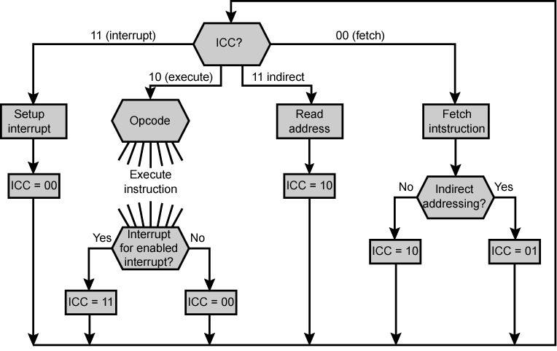
Flowchart for Instruction Cycle
The flowchart defines the complete sequence of micro-operations
At the end of each of four cycles, the ICC is set appropriately
The indirect cycle is always followed by the execute cycle
The interrupt cycle is always followed by the fetch cycle
For both the fetch and execute cycles, the next cycle depends on the state of the system

Slide 16
Types of Micro-operation
Transfer data between registers
Transfer data from register to external interface (e.g., system bus)
Transfer data from an external interface to register
Perform an arithmetic or logical operation, using registers for input and output
- All of the micro-operations needed to perform one instruction cycle, including all of the micro-operations to execute every instruction in the instruction set fall into one of these categories

Slide 17
Functions of Control Unit
The control unit performs two basic tasks:
Sequencing
  Causing the CPU to step through a series of micro-operations in the proper sequence
Execution
  Causing each micro-operation to be performed
This is done using Control Signals

Slide 18
Control Signals
Clock
  Causes one micro-instruction (or set of parallel micro-instructions) to be performed for each clock pulse. This is referred to as processor cycle time or the clock cycle time.
Instruction register
  Op-code for current instruction is used to determine which micro-instructions are performed
Flags
  State of CPU
  Results of previous operations
  e.g., for the increment-and-skip-if-zero (ISZ) instruction, the control unit will increment the PC if the zero flag is set
Control signals from control bus
  Provides signals to the control unit, such as interrupt signals and acknowledgements

Slide 19
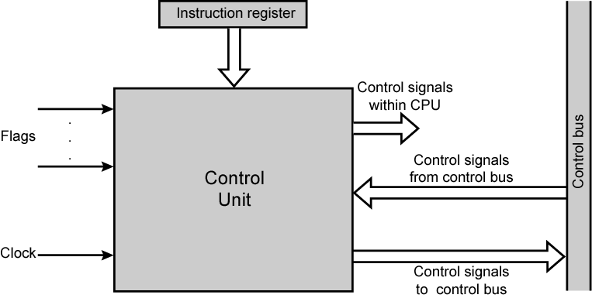
Model of Control Unit

Slide 20
Control Signals - output
Control signals within CPU
  Cause data movement from on register to another
  Activate specific ALU functions
Control signals to control bus
  Control signals to memory
  Control signals to I/O modules

Slide 21
Example Control Signal Sequence - Fetch
MAR <- (PC) [transfer contents of PC to MAR]
  Control unit activates signal to open gates between PC and MAR
MBR <- (memory) [Read a word from memory into the MBR and increment the PC]
  Open gates between MAR and address bus
  Memory read control signal on the control bus
  Open gates between data bus and MBR, allowing the contents of data bus to be stored in the MBR
  Add 1 to the contents of PC and store the results back to the PC

Slide 22
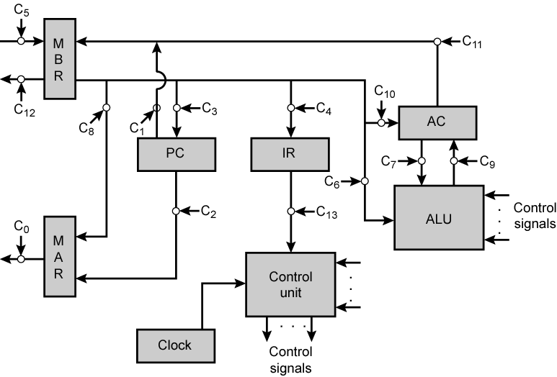
Control Signals Example: Data Paths and Control Signals
Control unit receives inputs from clock, instruction register, and flags.
With each clock cycle, the control unit reads all of its inputs and emits a set of control signals
Control signals go to three destinations:
- Data paths: The control unit controls the internal flow of data; e.g., on instruction fetch, the contents of MBR are transferred to IR. For each path to be controlled, there is a gate (indicated by the circle). A control signal from the control unit temporarily opens the gate to let data pass
- ALU: The control unit controls operation of ALU by a set of control signals
- System Bus: Control unit sends control signals out onto the control lines of the system bus (e.g., memory read)

Slide 23
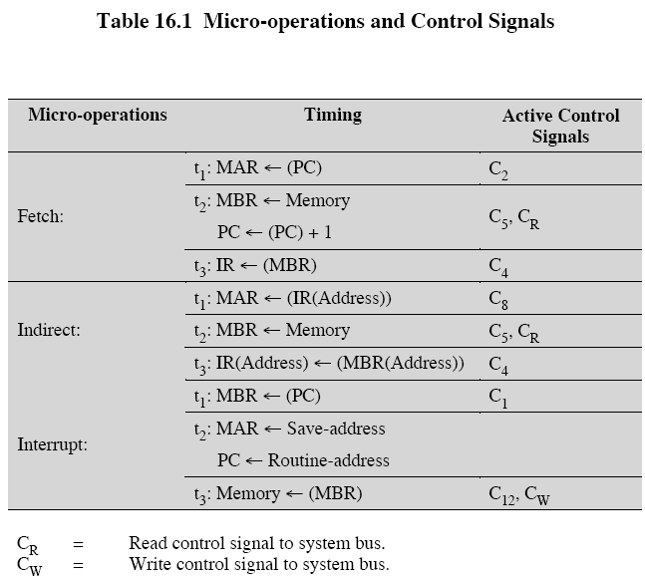
Micro-operations and control signals

Slide 24
Hardwired Implementation (1)
Control unit inputs
Flags and control bus
  Each bit means something
Instruction register
  Op-code causes different control signals for each different instruction
  Unique logic for each op-code
  Decoder takes encoded input and produces single output
  n binary inputs and 2^{n} outputs

Slide 25
Hardwired Implementation (2)
Clock
  Repetitive sequence of pulses
  Useful for measuring duration of micro-ops
  Must be long enough to allow signal propagation
  Different control signals at different times within instruction cycle
  Need a counter with different control signals for t1, t2 etc.

Slide 26
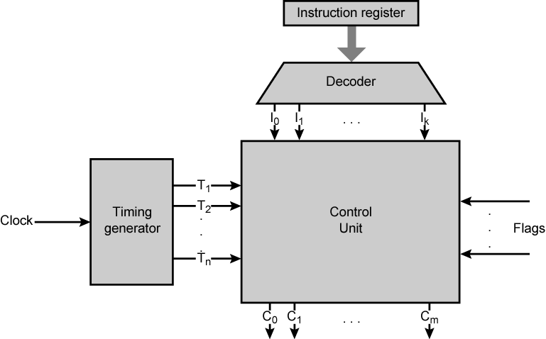
Control Unit with Decoded Inputs

Slide 27
Problems With Hard Wired Designs
Complex sequencing & micro-operation logic
Difficult to design and test
Inflexible design
Difficult to add new instructions

